Slide 1
COVID-19 Returning to work safely
June 2020

Slide 2
Employers Legal Obligations
With the easing of lockdown and more people returning to work, it’s even more imperative that your employer ensures you have a safe place of work

Slide 3
Lets get this straight!
You don’t have to be a Covid virus expert!
Or even a health and safety expert
But you need to be aware of some key legal responsibilities your employer has to keep you safe.

Slide 4
Remember – The Key Basis of UK’s Health and Safety at Work Policy is: The RISK ASSESSMENT
To ensure your workplace is safe your employer must by law carry out a risk assessment.

Slide 5
Returning to work safely- What your employer must do
Conduct a Covid -19 Risk Assessment
Give out information
Adhere to ‘Covid Secure’ govt guidelines
Implement measures from the Risk Assessment
Consult meaningfully
Adhere to all health and safety laws and advice
Involve staff through union reps

Slide 6
What is ‘COVID Secure’?
This is a phrase used by the UK government to ensure that employers make their work operations as safe as possible for employees when they return to work.
There are 5 key points to implementing COVID Secure working practices
See next slide

Slide 7
5 key points to implementing COVID Secure working practices:
Work from home, if you can
Carry out COVID-19 risk assessment in consultation with workers and trade unions
Maintain 2 meters social distancing, wherever possible
Where people cannot be 2 meters apart, manage transmission risk
Reinforcing cleaning processes
UNISON and other health unions have produced a 9-Point Blueprint for the safe opening up of NHS services.

Slide 8
Covid-19 Risk Assessment
Consulting with staff and unions
Government has stated that the Covid-19 Risk Assessment must be carried out in consultation with workers or trade unions to identify what guidelines to put in place.
If 50 or more employees, employer must publish risk assessment on their website

Slide 9
Recommended Risk Assessment Framework for Employers*
Evaluate risks
Decide on control measures
Record findings
Implement control measures
Review and update if necessary
* Health and Safety Executive

Slide 10
Covid-19 Secure- Risk Assessment for Employers
Covid-19 Risk Assessment
Review and update if necessary
Decide on likelihood of someone being exposed to the virus
Think about who could be at risk
Identify what activities or situations might cause transmission
Remove the activity or situation, or where not possible, control the risk

Slide 11
Assessing who is most at risk depends on:
Type of work being done
Exposure to risk
Interactions with infectious people/material
Contamination of the work environment
Age and pre existing conditions and BAME
Government advice for various sections of the health workforce - See useful information slide.

Slide 12
Hierarchy of Control
Employers should use what is called a “Hierarchy of Control”.
This is used to “rank” how effective controls can be and the order in which they should be used.
Although it is often called a hierarchy they must consider all measures, and how effective they are when applied together. Any control measure (including PPE) should be funded by the organisation

Slide 13
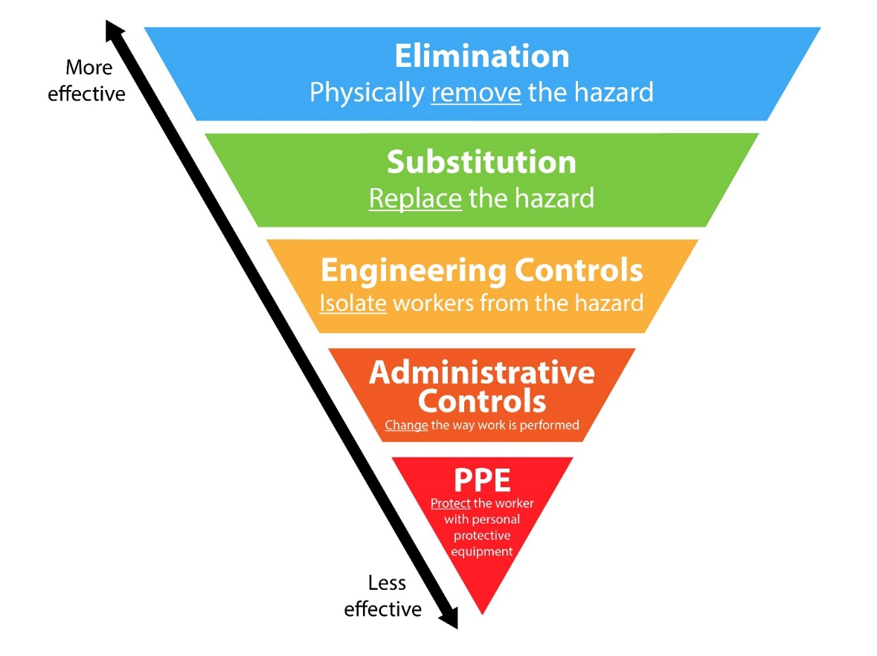
Hierarchy of Control

Slide 14
Corona 19 Risk Assessment Hierachy of Control -Examples
Eliminate
Substitute
Engineer
Administrate
Personal Protective Equipment
Work from home
Virtual meetings
Face masks, coveralls, gloves, aprons etc
Physical partitions
Work rotation, altered shifts, breaks
See appendix for more detailed examples

Slide 15
Questions employer must ask
Who can work from home?
What’s the minimum number of people I need in the workplace?
Who is at higher risk?
What personal protective equipment do my employees need?
Which jobs and tasks can be changed to minimise risk of transmission?
How do my employees get to work?
How to reduce the risk for those who travel to work?
How do I implement the 2 meter rule?
How can we make sure hygiene rules are followed?

